Slide 1



Introduction
A company called Wavecon Telecommunication facilitated telecom service in India just like Jio and Airtel.
The company upgraded from 4G to 5G.
5G services were first launched in India by Prime Minister Narendra Modi on October 1, 2022.
The 5G network was made available on October 4th in Delhi, Mumbai, Varanasi, and Kolkata.
AtliQ Technology Pvt Ltd
- Ajay

Slide 2
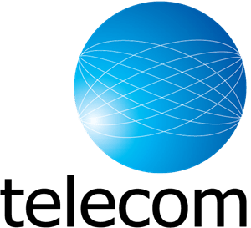
The objective of this analyzed presentation.
Our client Wavecon Telecom was facing issues after releasing 5G in India.
Decrement in revenue and subscribers.
Gradually their market share started declining.
Subscribers began to migrate to other telecommunications companies.
Some of their recharge plans were significantly affected by these challenges.
W

Slide 3

Why do we need to do 5G transition?
5G networks offer several advantages over 4G networks, such as
faster data transfer speeds,
lower latency
higher network capacity
5G networks are expected to revolutionize several industries by enabling the development of new applications and services that require high-speed, low-latency data transfer.

Slide 4
What is the impact of the 5G launch on our revenue?
Revenue
Difference in Revenue
Before 5G
₹‎16 Billion
After 5G
₹‎15.9 Billion
- 0.50%

Slide 5
Average revenue per user
Changes After and Before 5G launch
Before 5G
₹‎190.2
After 5G
₹‎211.3
Difference in ARPU
11.05 %

Slide 6
Total Active User
Before 5G
₹‎84.4 Million
After 5G
₹‎77.4 Million
Difference in Revenue: 7 M
- 8.28%

Slide 7
Total Unsubscribe User
Difference in TUnU: 1.3 M
Before 5G
₹‎5.6 Million
After 5G
₹‎6.9 Million
23.5 %

Slide 8
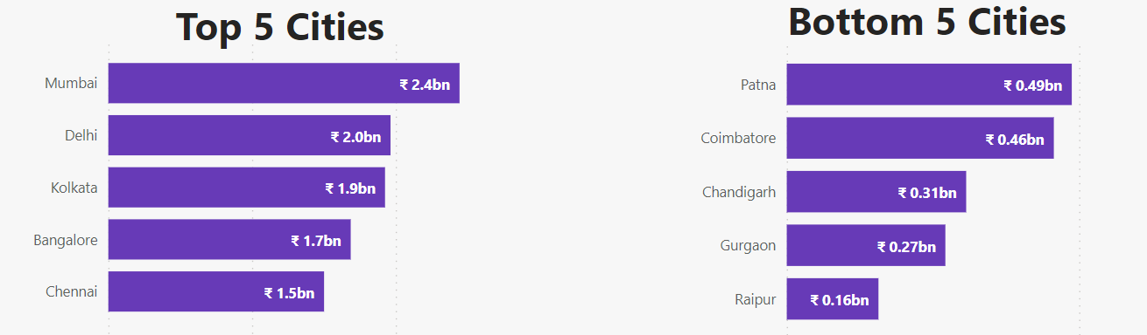
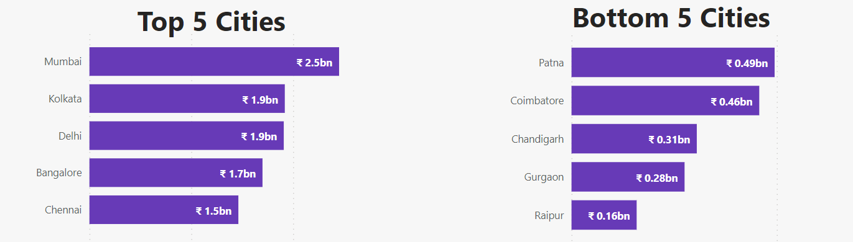
Revenue before 5G launch
Revenue after 5G launch

Slide 9
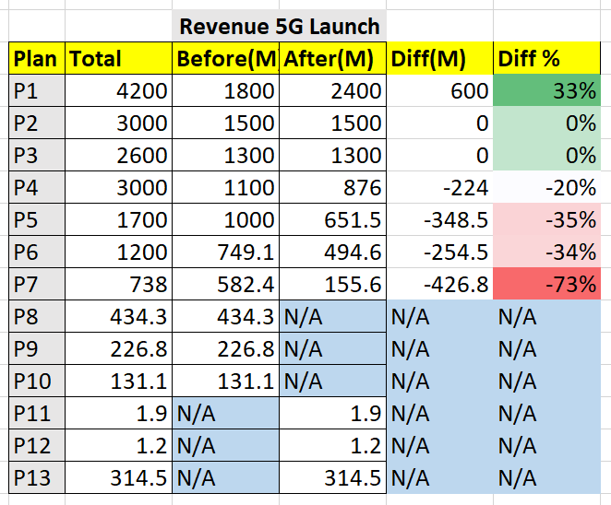
After the 5G launch, which plans are performing well in terms of revenue?
Which plans are not performing well?
After 5G launched, plan 1
(Smart recharge pack 2gb/day)
is performing Well, 33 % increase in revenue rate.
And plan 7 is the worst performing.
(25 GB combo pack)

Slide 10
Is there any plan affected largely by the 5G launch?
Should we continue or discontinue that plan?
Plan 7 (25 GB combo pack)
is the worst-performing
Around 73% revenue decreased after 5G launched.

Slide 11
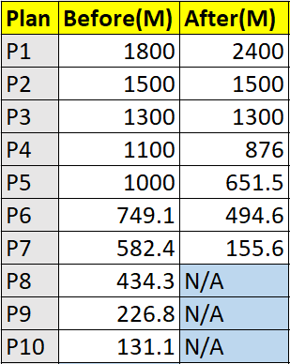
Is there any plan that is discontinued after the 5G launch?
What is the reason for it?
Discontinued Plans
P8 (daily saviour 1 GB)
P9 (Combo Top-up)
P10 (Big Combo pack)

Slide 12

Conclusion
Total active users reduced to 7: M
And total unsubscriber 1.3M
Enhancing the revenue of a telecom service can be achieved through various unique strategies and approaches. Here are few points to consider:
Market Trend and Demand: By adapting to market new trends and customer demands, webcon telecom can unlock new revenue opportunities and stay competitive in a rapidly evolving industry.
Value-Added Services (VAS): These could include services like IoT (Internet of Things) connectivity, home automation, telehealth solutions, or entertainment packages.
Content Partnerships: Collaborating with content providers, such as streaming platforms, gaming companies, or educational institutions.
Business Solutions: Offer services like cloud-based communication systems, cybersecurity solutions, or unified communication platforms.
Network Infrastructure Sharing: Collaborating with other telecom providers to share network infrastructure can lead to cost savings and revenue generation.
Partnership: Webcon Telecom can reduce capital expenditure and generate income from their underutilized assets by renting out excess network capacity or partnering on infrastructure expansion projects

Slide 13


Dhaval Sir
Hemanand Sir
Thanks to the codebasics team
And AtliQ Technology for this presentation challenge.

